Slide 1

Airlines Reservation System
SUBMITTED TO
Department of Computer Science & Engineering
by
Tarushi Tiwary, 220905171, 24
Chiranth Reddy, 220905185, 26
Saiswasthik S, 220905021, 4
Bradley G, 220905091, 12
III Semester, CB Section

Slide 2

INTRODUCTION
The Airlines Reservation System is a sophisticated software application coded in Java, designed to streamline and automate the process of airline ticket reservations. This system leverages various aspects of Java, including constructors, inheritance, interfaces, packages, multithreaded programming, and generics, to provide a comprehensive and efficient solution for both travelers and airline companies.

Slide 3

METHODOLOGY

Slide 4
Object-Oriented Programming (OOP) Principles
Here are the specific aspects related to OOP in the code.
Classes and Objects: The system utilizes classes to encapsulate entities like flights and reservations, and objects are created from these classes to perform specific tasks. The 'Flight' class is an example
Constructors: Constructors are used to initialize objects. The code features parameterized constructors in classes like 'Flight.
Inheritance: While not explicitly demonstrated in the code, the concept of inheritance is indirectly applied through OOP design principles. Classes are designed to encapsulate their functionality, promoting code reusability and maintainability

Slide 5
2. JavaFX Integration
JavaFX is a pivotal component in creating a user-friendly graphical user interface (GUI) for the Airlines Reservation System.
GUI Components: JavaFX is used to create various graphical components, such as windows, buttons, choice boxes, labels, and spinners. These components are essential for providing a user-friendly and interactive interface, enabling users to interact with the system seamlessly
Event Handling: JavaFX's event handling mechanisms are utilized to capture user interactions and trigger actions. For example, when a user clicks the "Calculate Price" button, an event handler is used to initiate the price calculation and update the displayed price label.
Layout Management: JavaFX provides layout management tools that are used to structure the interface.

Slide 6

3. Reservation System Implementation
ReservationSystem Interface: The ReservationSystem interface is defined and implemented in the code. It serves as a contract that classes must adhere to.
SimpleReservationSystem Class: The SimpleReservationSystem class serves as an example implementation of the ReservationSystem interface. It contains the logic for calculating the price of flight reservations based on the selected flight and the number of travelers

Slide 7
4. Code Organization with Packages
'Airline' Package: The primary package, 'Airline,' houses the main application code. It contains the App.java class, which creates the user interface and controls the system's functionality.
'Interface' Package: The 'Interface' package is dedicated to the ReservationSystem interface. It defines the contract for the reservation system, ensuring that any implementation adheres to the specified method signatures

Slide 8
5. Usage of Generics
Java's generics feature is used in the code, primarily through the Spinner class from JavaFX.
The Spinner class is parameterized with the Integer generic type to specify the type of values it can handle. This ensures compile-time type safety and prevents invalid input. For instance, the Spinner for selecting the number of travelers is configured to accept only integer values, enhancing code reliability.

Slide 9
6. Exception Handling
Custom exception named NotEnoughSeatsException is defined to handle cases where there are insufficient seats on a flight.
SimpleReservationSystem implements the ReservationSystem interface and calculates reservation prices, utilizing exception handling.
The calculatePrice method throws NotEnoughSeatsException if there are fewer available seats than the number of travelers.
The UI part of the code captures user input and uses try-catch to handle NotEnoughSeatsException, providing error messages for users.
Exception handling ensures smooth application operation and user guidance when seat availability issues arise during reservation.

Slide 10

CONCLUSIONS AND FUTURE ENHACEMENTS
The Airlines Reservation System is a user-friendly application utilizing Java's OOP and JavaFX for airline ticket reservations, enhancing efficiency and reducing errors.
Exception handling is crucial for robustness and reliability, effectively managing exceptional scenarios and providing informative error messages.
Code organization into distinct packages ('Airline' and 'Interface') contributes to maintainability and facilitates exception management.
Generics usage, particularly in the Spinner class, enforces type safety and prevents runtime errors.
The system provides a solid foundation for future enhancements and user-centric features.

Slide 11
Future Enhancements
Future Enhancements:
User Authentication and Profiles
Integration with External Systems
Advanced Pricing Algorithms
Mobile Application
Additional Services
Multi-Language Support
Real-Time Flight Information
Feedback and Rating System
Accessibility Features
These enhancements can improve user experience, streamline operations, and ensure the system's relevance in the airline industry.

Slide 12
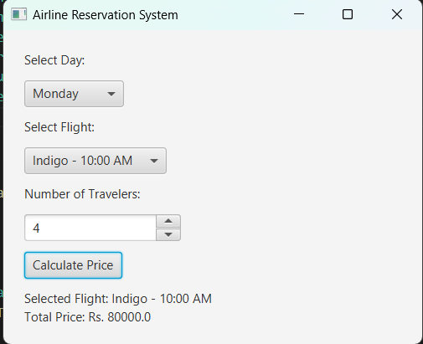
Input And Output

